Slide 1
The People and the Credit Markets
Jeffrey Dean

Slide 2
Section 1: Customer Profiles
The first section will look at the type of products that customers of credit or financial products would use and profiles of such customers.
Due to privacy and limited data, I have built the analysis around customers of real estate products such as mortgages
This analysis helps show who is using credit products and how when learning about complaints or fraud issues.

Slide 3
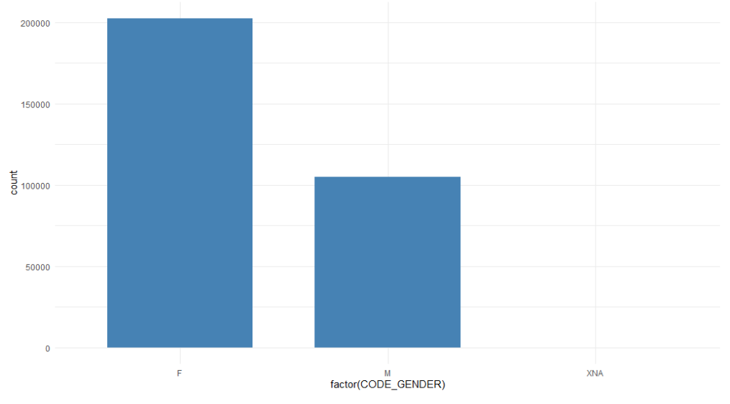
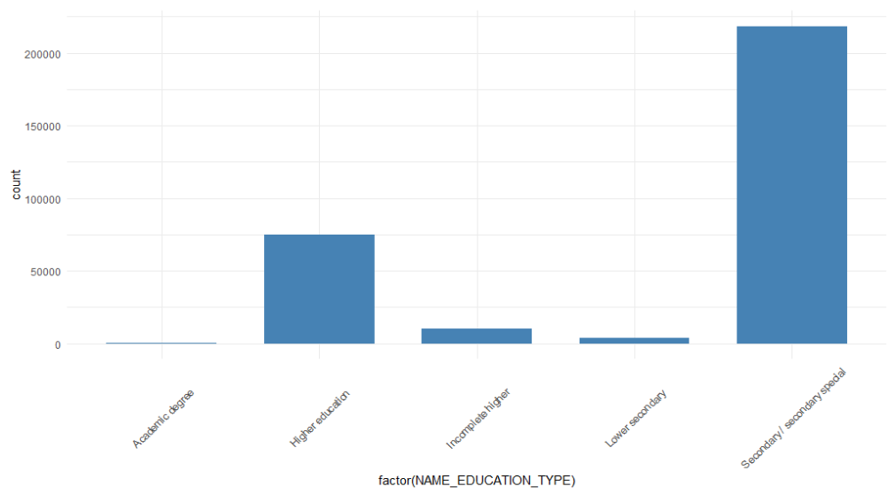
Customer Profiles

Slide 4
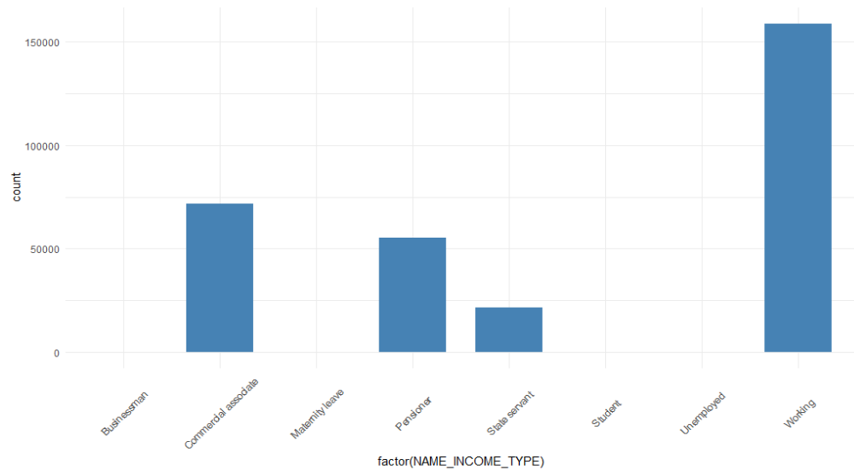
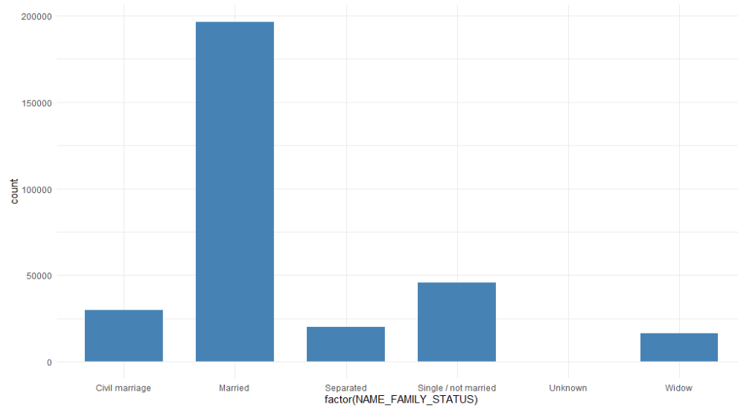
Customer Profiles

Slide 5
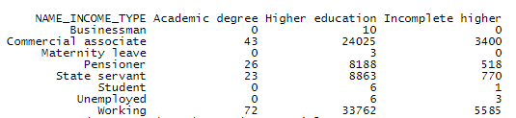
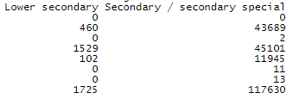




Customer Data Comparisons

Slide 6
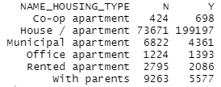

Customer Data Comparisons

Slide 7
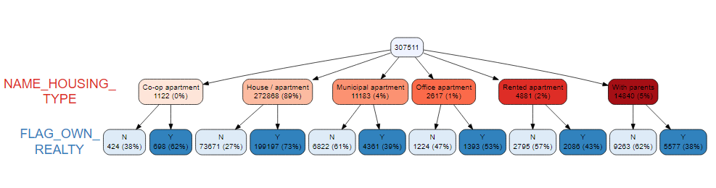
Types of Products

Slide 8
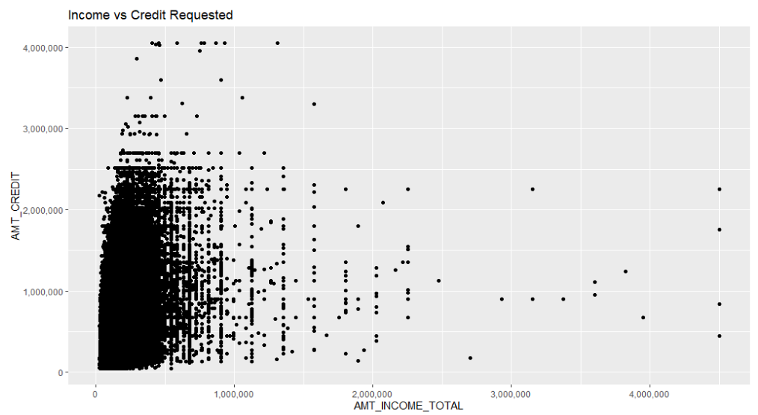
Annual Income vs Credit Application

Slide 9
Section 2: Bank Complaints
The next section is information and graphics about types of complaints against financial institutions and their frequency.
The information is shown by geography and over time, hopefully to support any patterns that exist in practice.

Slide 10
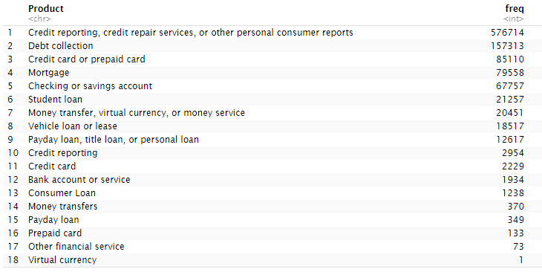
Product Type by Frequency

Slide 11
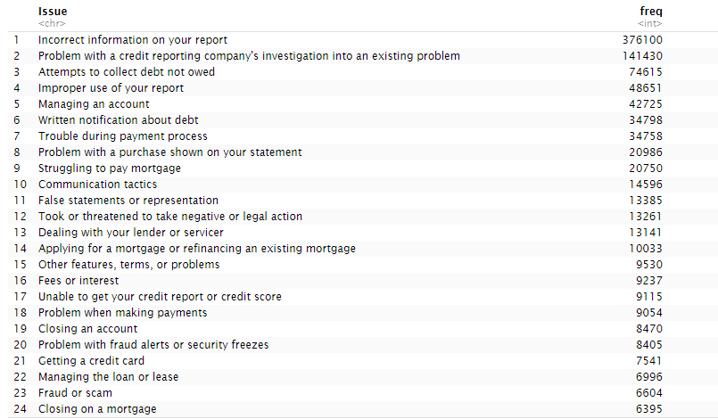
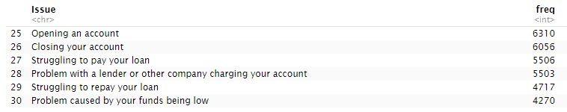
Issue Type by Frequency

Slide 12
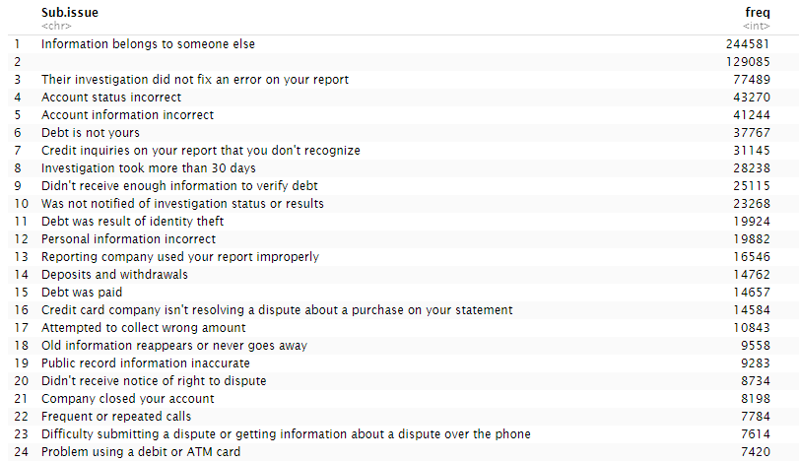
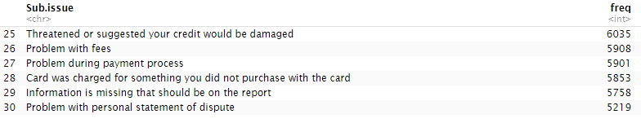
Sub-Issue by Frequency

Slide 13
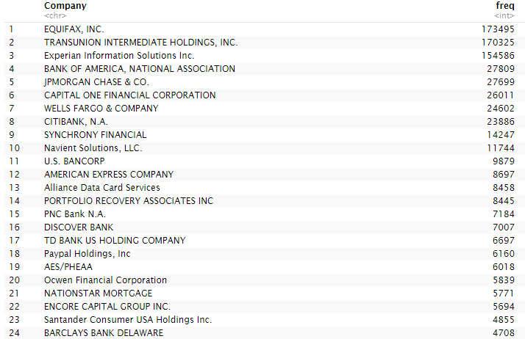
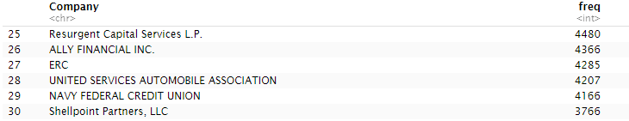
Financial Institution by Frequency

Slide 14


Bank Complaint Comparisons

Slide 15
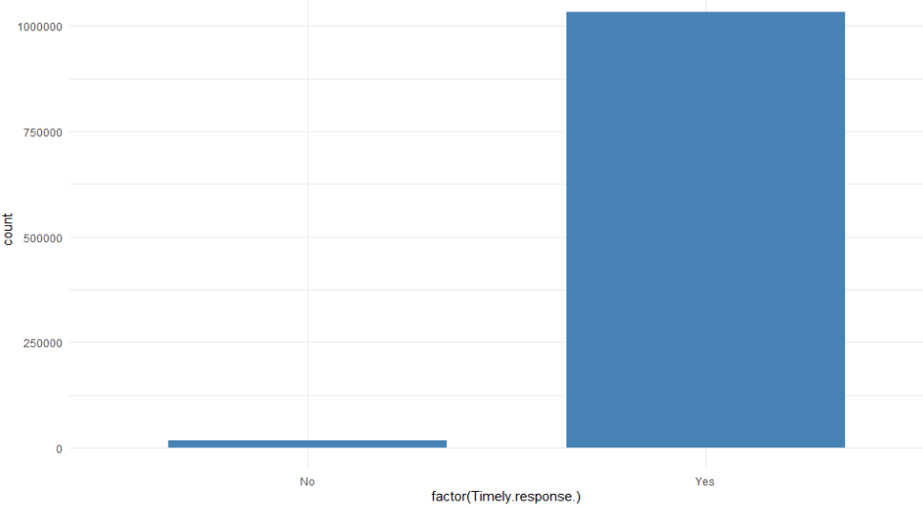
Bank Complaint Comparisons

Slide 16
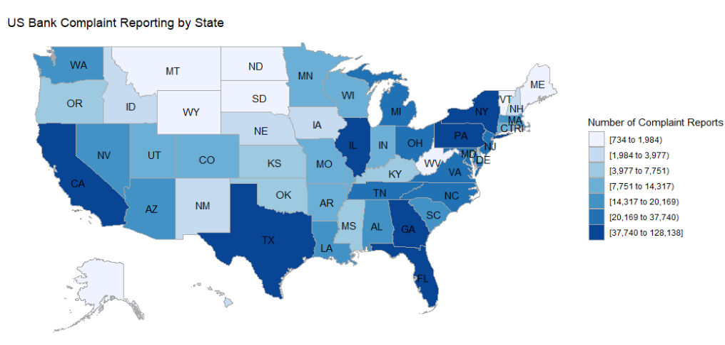
Bank Complaint Choropleth

Slide 17
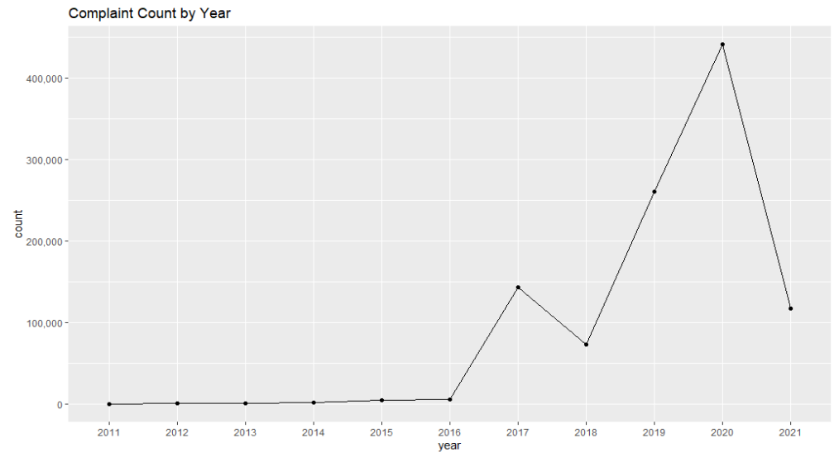
Bank Complaints by Year

Slide 18
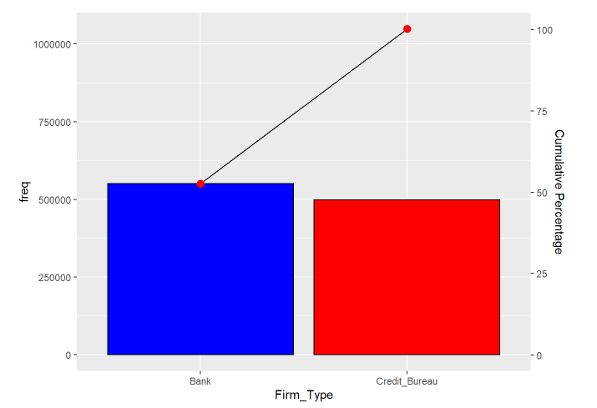
Pareto Analysis

Slide 19
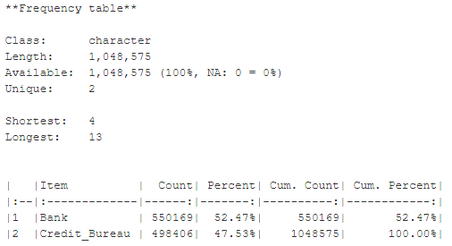
Frequency Table

Slide 20
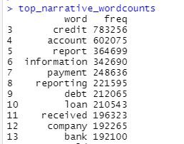
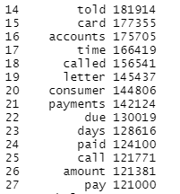

Top Words: Bank Complaint Narratives

Slide 21
Section 3: Fraud in Action
Below is data I found from tables of fraud cases that have occurred by geography.
The data is for 2020; this is the most up to date given how it was compiled annually.

Slide 22
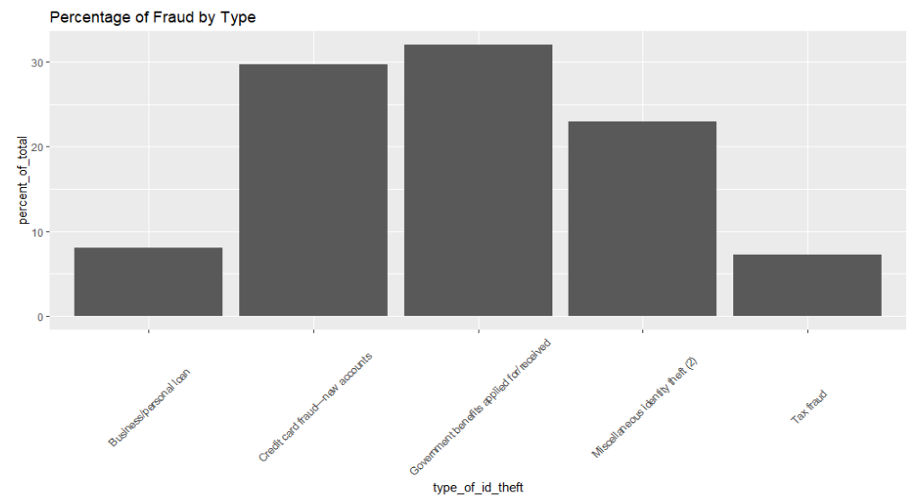
Types of Fraud and Frequency

Slide 23
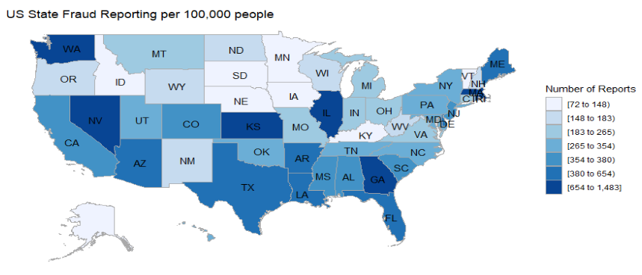
Fraud by State Choropleth

Slide 24
Conclusions
We can see patterns that have emerged in each section, although most of the data fits what I already expected.
The biggest deviation from what I thought I would see is that instead of banks being the biggest recipient of complaints, it ended up being the credit reporting agencies. The remaining details of the analysis are contained within my R markdown file.

Slide 25

Any Questions?

Slide 26
Link to My GitHub
Contains this project and others I have worked on.
GitHub: https://github.com/TheDean95

